Slide 1
CRICKET SCORE BOARD

Slide 2
ABSTRACT
This project implements an application which acts as a cricket score calculator, whose aims are to provide users with a smooth and easy way to calculate cricket score during any match.The programming language used in this project is C.
The program asks for inputs on each ball of the match using which several data is calculated and stored. The information calculated consists of current run rate, required run rate, projected score, wickets remaining, individual stats of a player and obviously the present score. The duration of the match (overs) can be set by users.
The main objective of implementing this project is that, it can be used for storing and calculating data for short duration and local matches especially for college tournament matches and also for casual/friendly matches.Though the scope of this project seems to be faded, but it becomes really helpful when the following facts are considered like prevents manipulation of data as stored in a soft copy which cannot be changed, fast and accurate calculations since this is done by a computer rather than human who often has to chance to miscalculate ,easy inputs through keyboard, can store huge amount of data regarding the match/tournaments without the risk of being damaged/losing it. But, this, being a program can be only accessed by programmer.

Slide 3
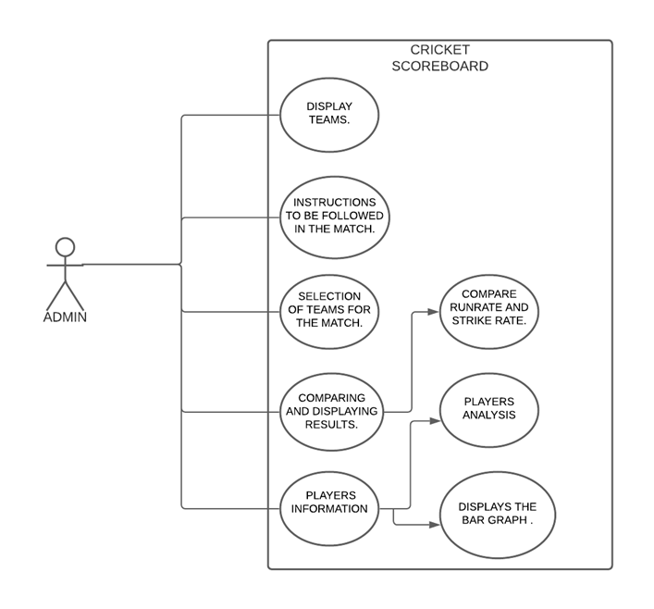
USE CASE DIAGRAM

Slide 4
Hardware Requirements & Software Requirements:
The System need some basic hardware to run . Those are:-
1. Good memory hard disk.
2. 8GB RAM.
3. 64 bit Machine
4. Good display facilities
To run this project we need some basic software in computer/laptop.
Those are:-
1.Text editor/Notepad.
2. An application to support and execute
the Programming Language.

Slide 5
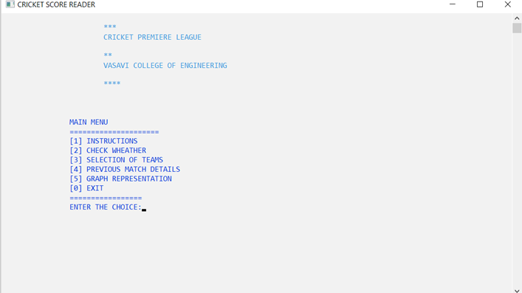
RESULTS

Slide 6
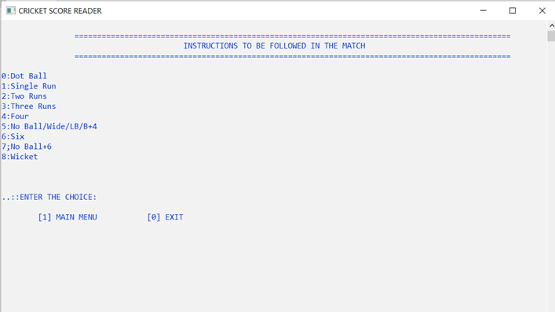

Slide 7
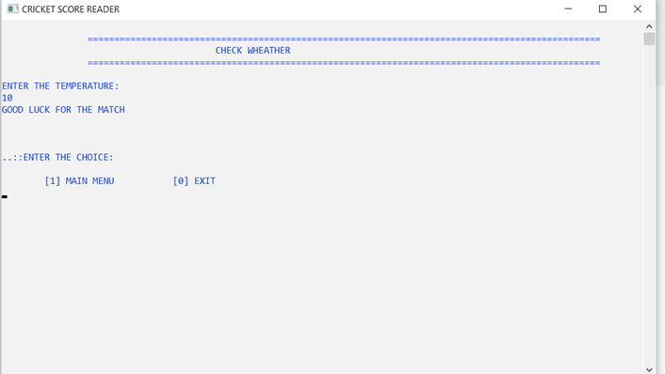

Slide 8
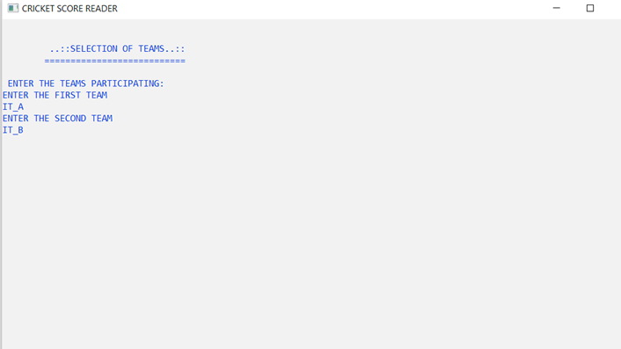

Slide 9
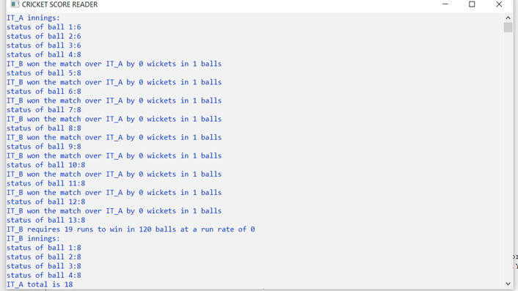

Slide 10
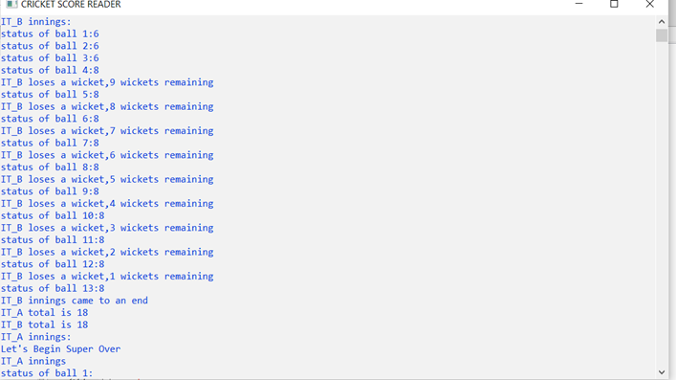

Slide 11
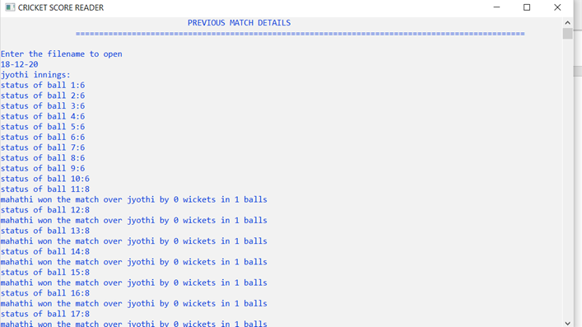

Slide 12
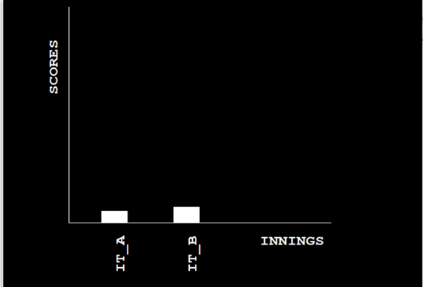

Slide 13
Conclusion & Future Enhancements:
• Our project and implementation is on Cricket Score board. We have successfully completed it. We take this opportunity to express our sense of indebtedness and gratitude to all those people who helped us in completing the project and implementation.
• We are immensely grateful to our esteemed project guidance without which this work would not have been possible.
• This project and implementation has contributed a lot to our knowledge that has proved to be a value addition for us.
· The future of our system might change the tournament level cricket competitions.
· The cricket score calculations can be made easier without any waste of time.
· This system is easily available and its scope and lifetime is high

